Slide 1
Steganography Using S-Tools

Slide 2
Background

Slide 3
File carving
A well known computer forensics term
To identify and extract (carve) the file
from unallocated clusters
without the assistance of the file system that originality created the file.
How to extract files?
based on signature information alone.

Slide 4
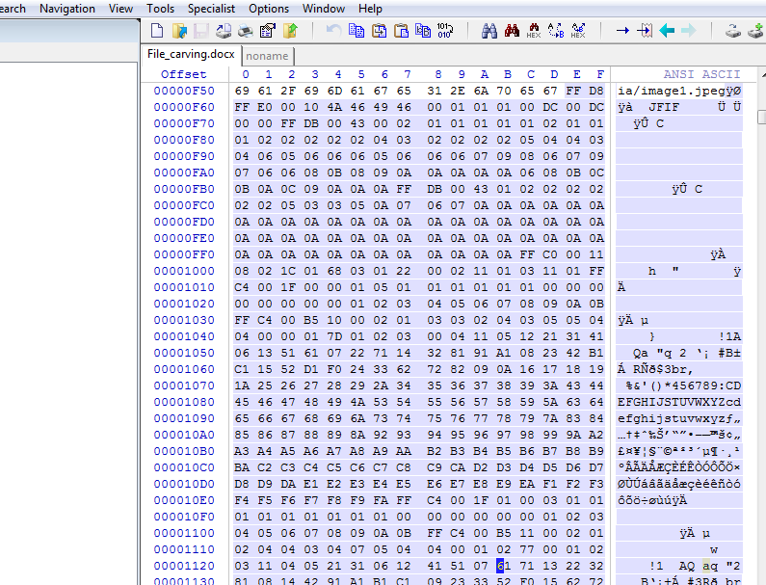
An example scenario
A suspect deleted a file
The files contains an important image
Image occupies a few clusters
Unfortunately, some clusters are reused (0verwirtten) by new files
A forensic expert really wants to recover the image, even a partial image

Slide 5
File signature
Referred to as a magic number,
Used to identify a file format
a constant numerical or
text value used to.

Slide 6
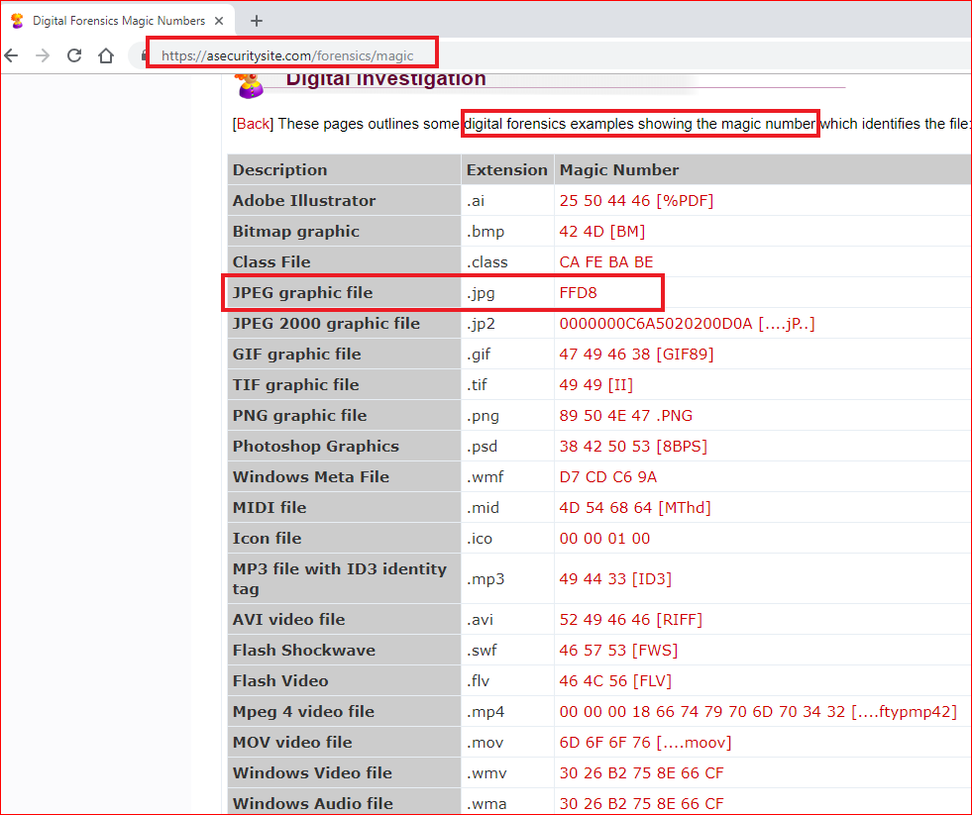
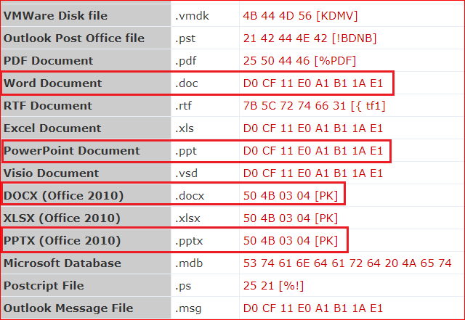

Slide 7
Verify all the required files for the lab

Slide 8
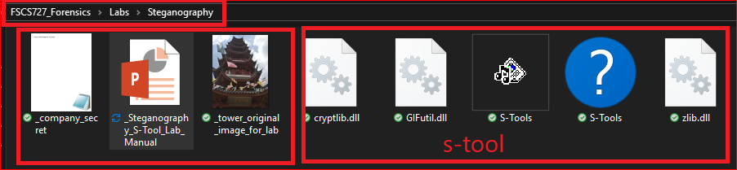
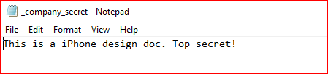

Slide 9


The lab goal
Hide (embed) the text file (company -secret.txt) in the image.

Slide 10
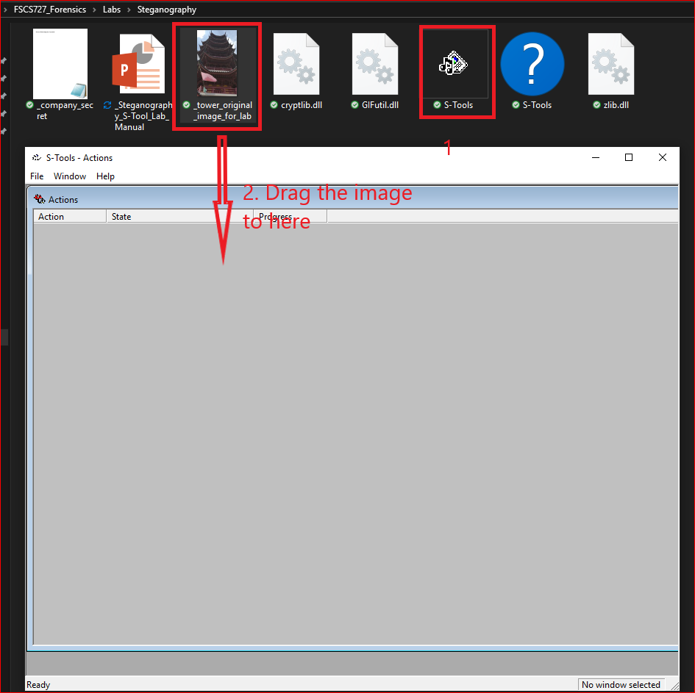
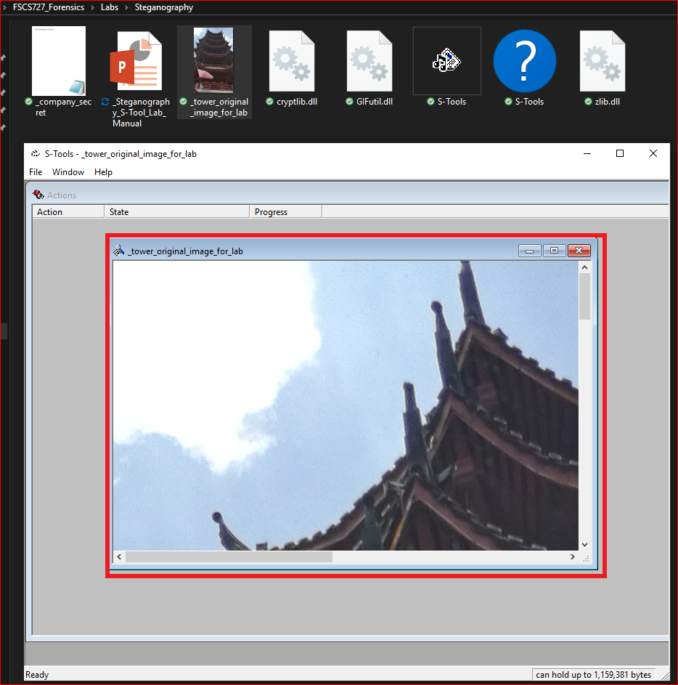

Slide 11
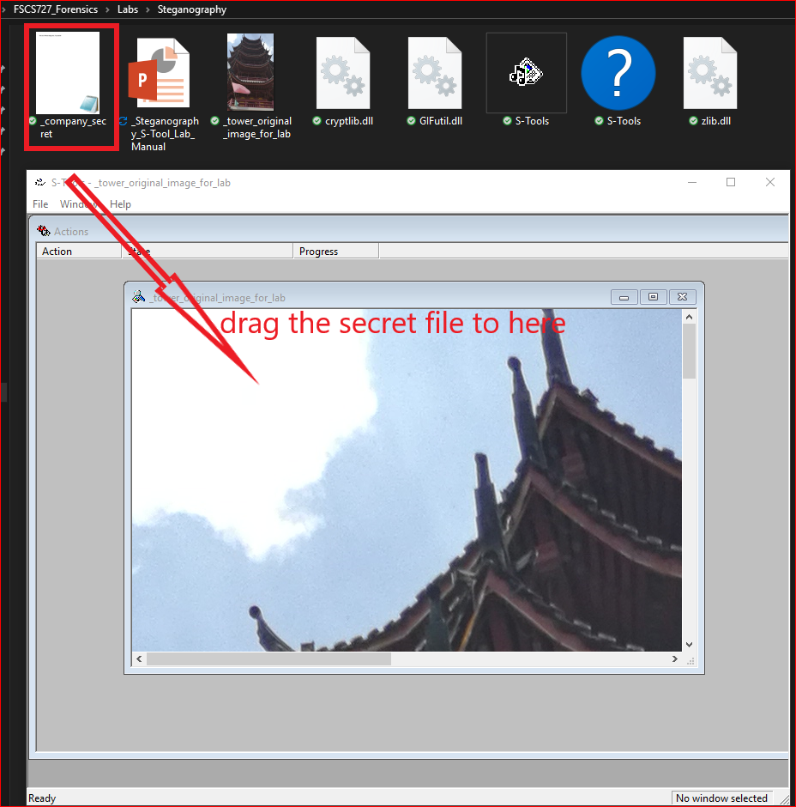
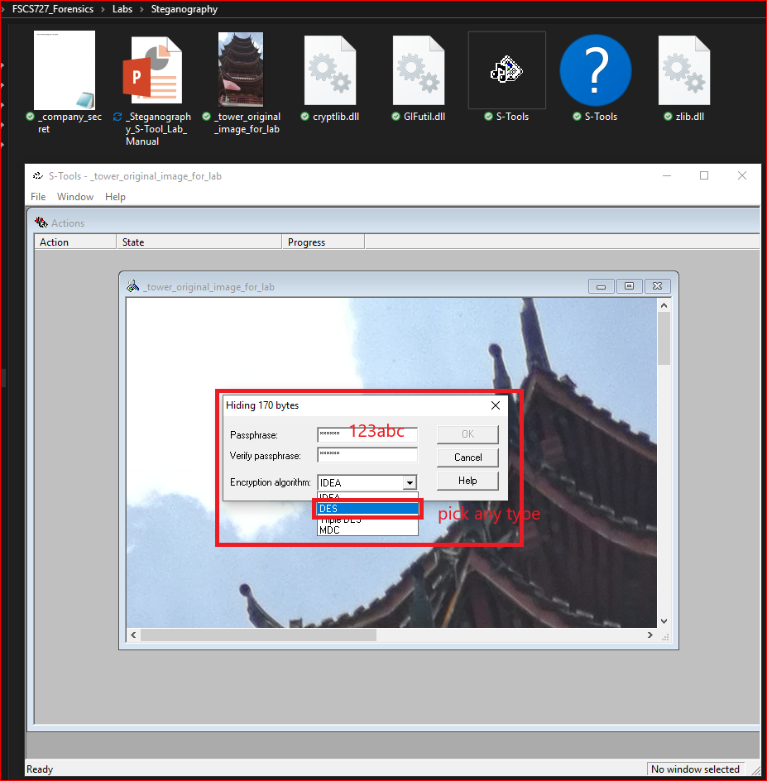

Slide 12
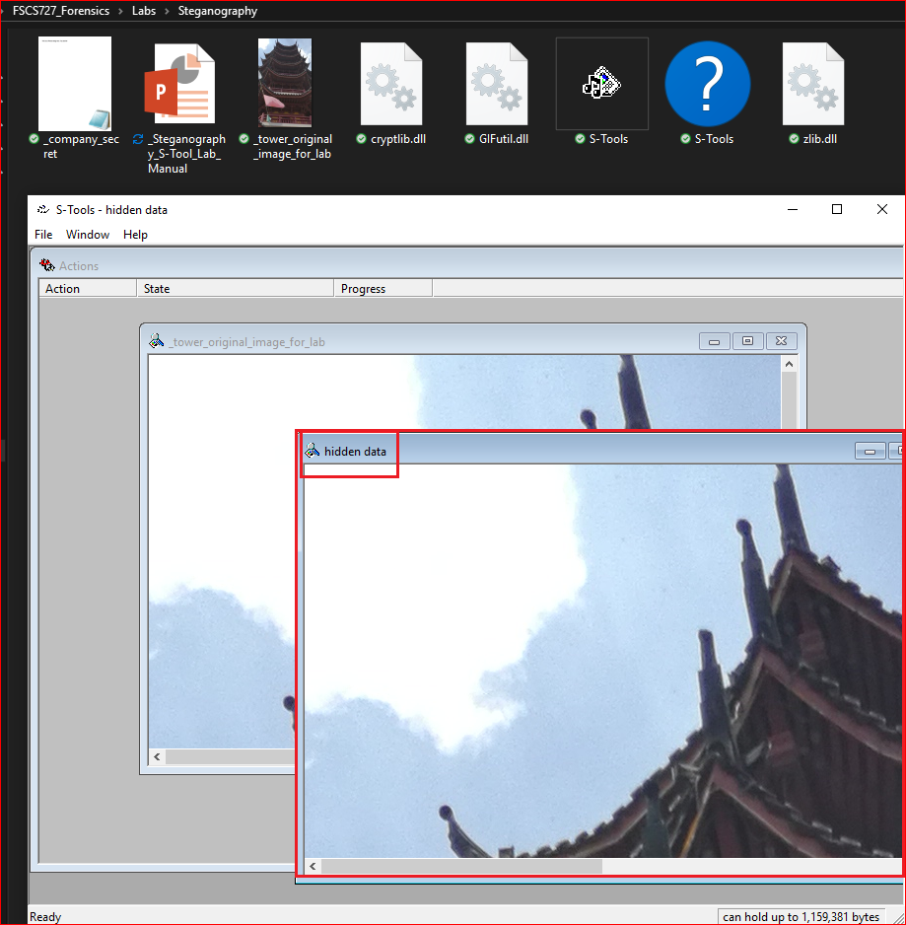
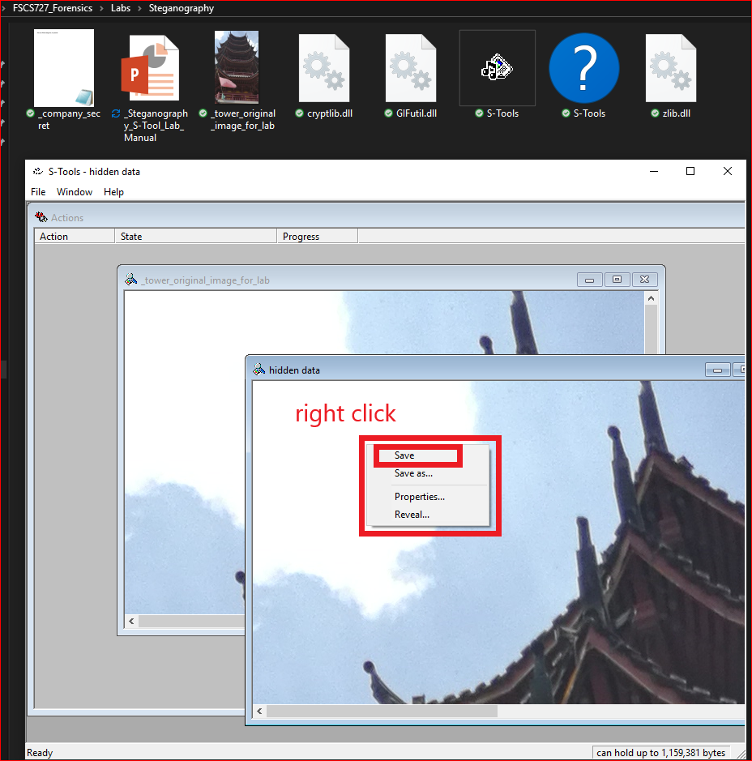

Slide 13
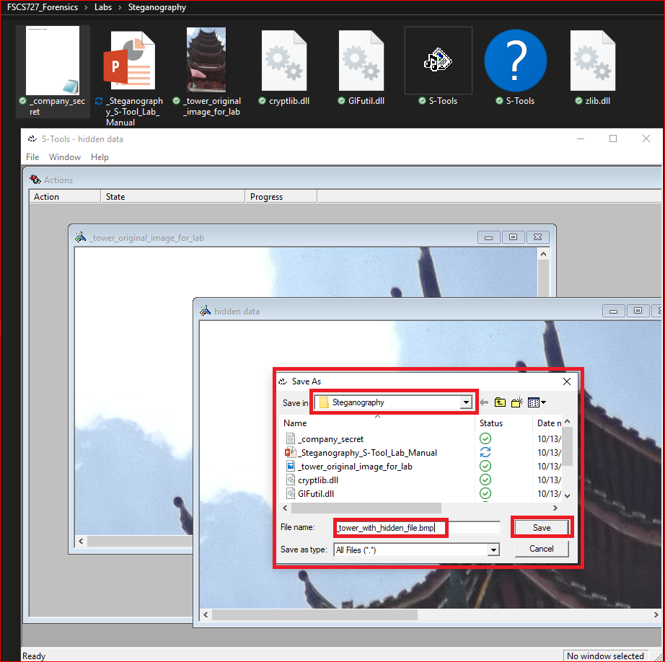
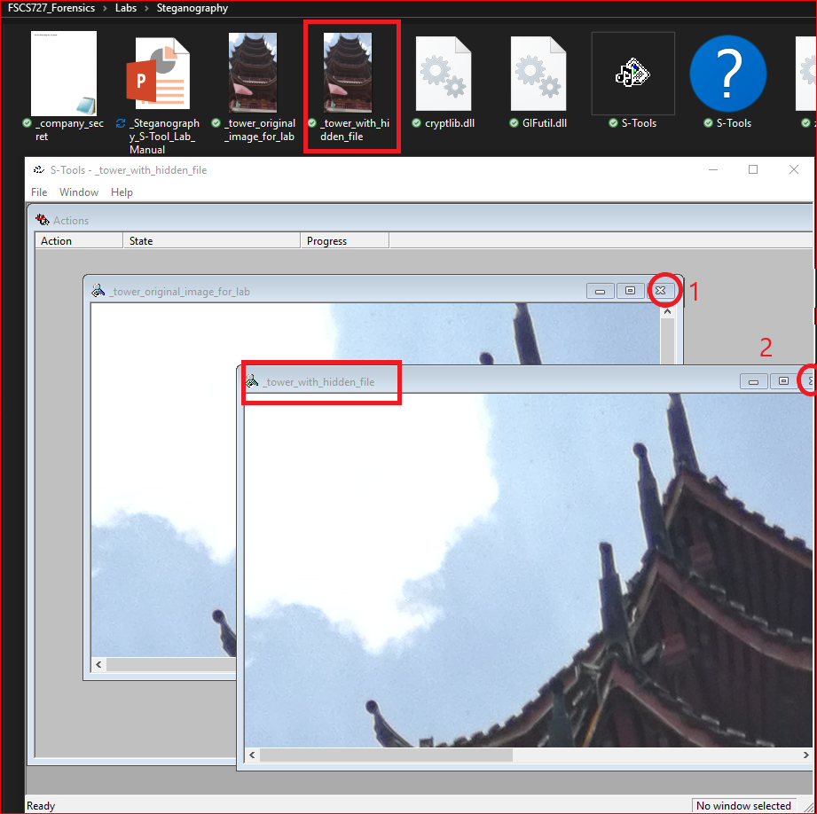

Slide 14
Extract the hidden file from an image

Slide 15
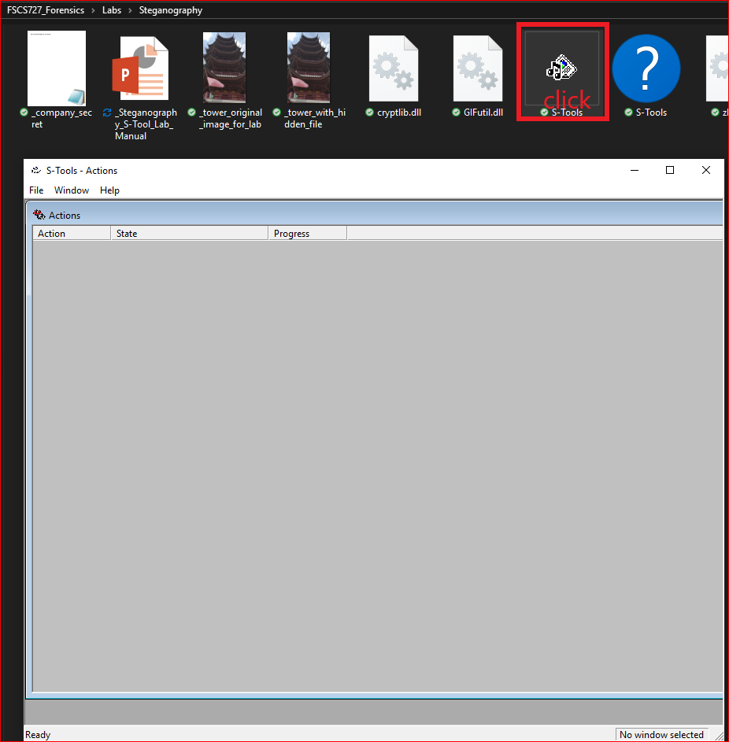
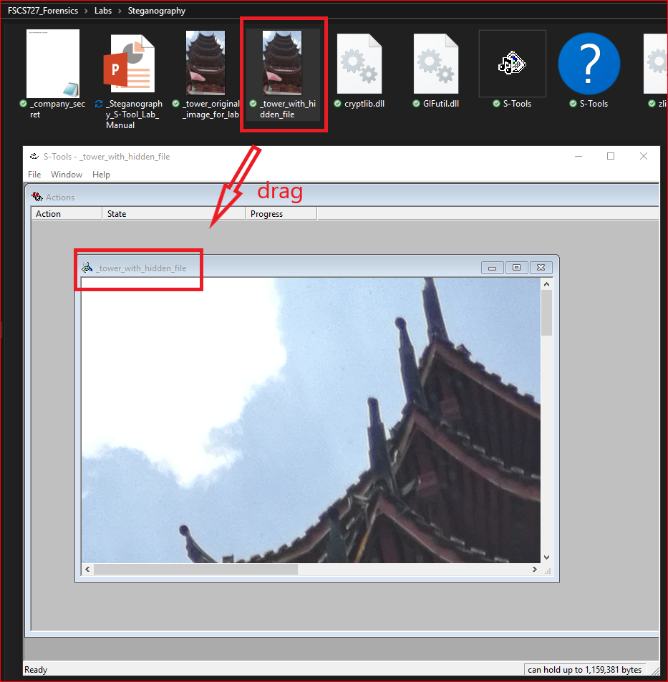

Slide 16
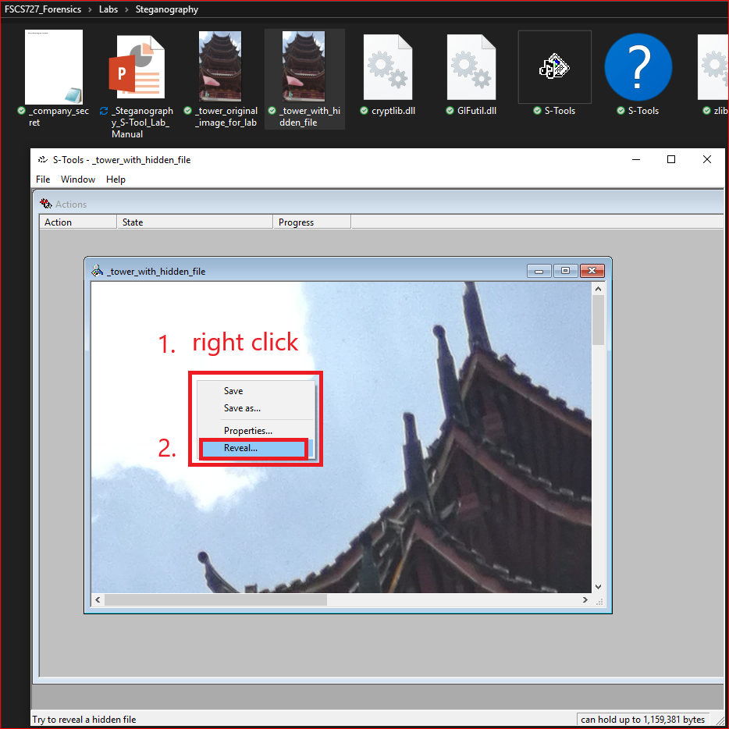
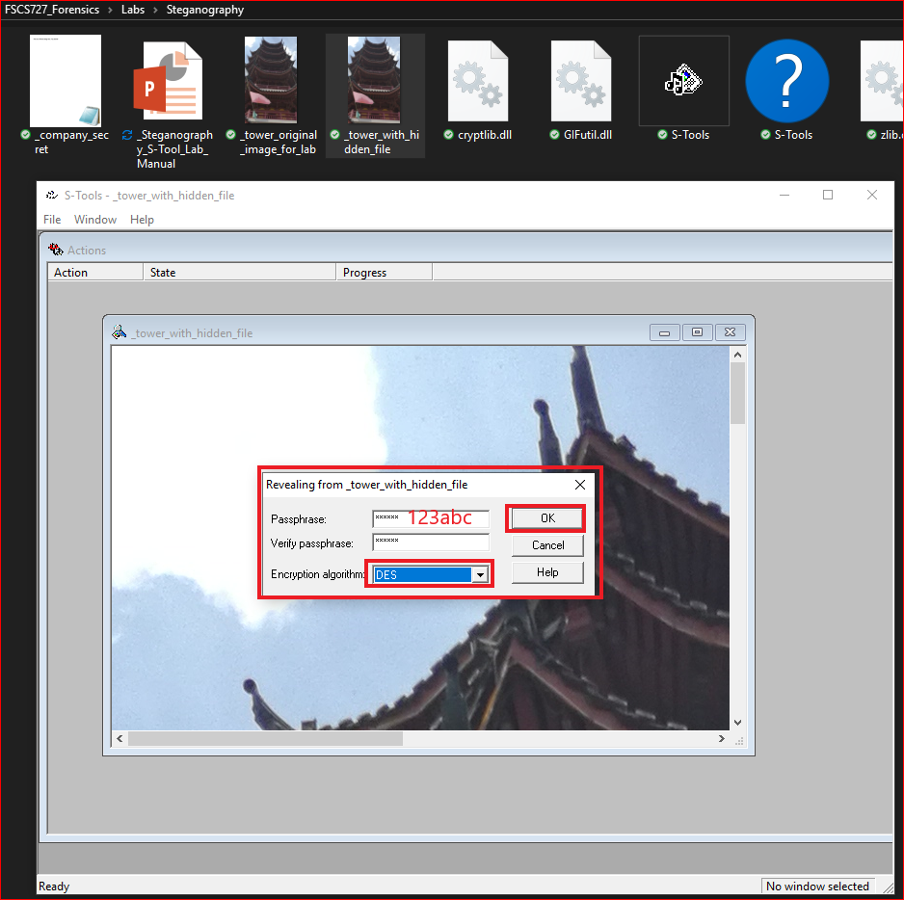

Slide 17
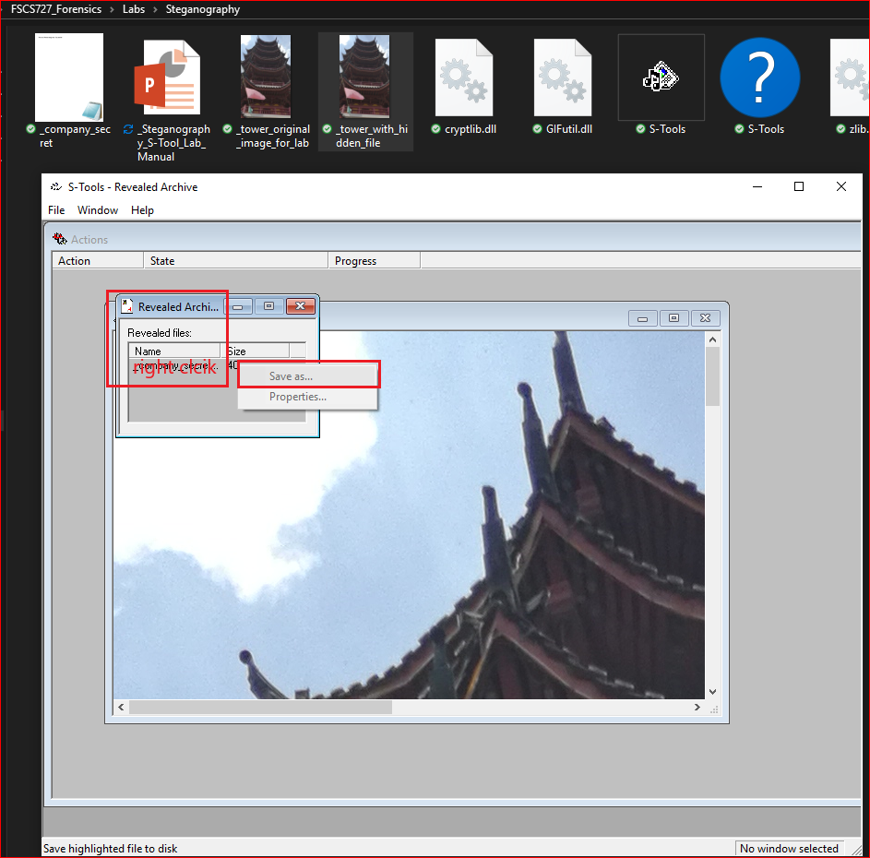
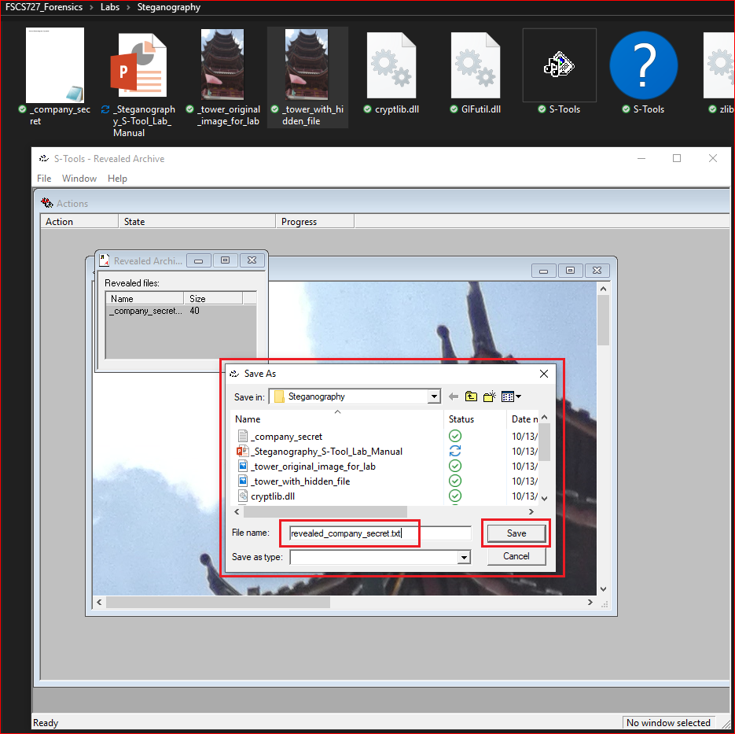

Slide 18
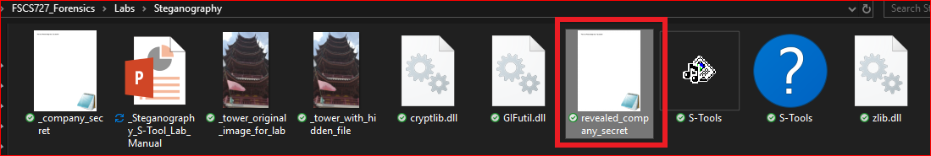
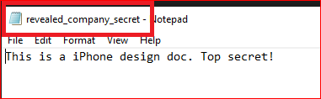

Slide 19
Difference between two image files

Slide 20
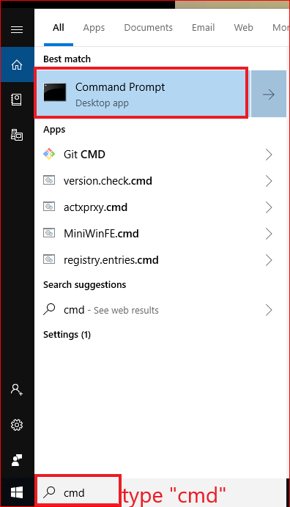

Slide 21
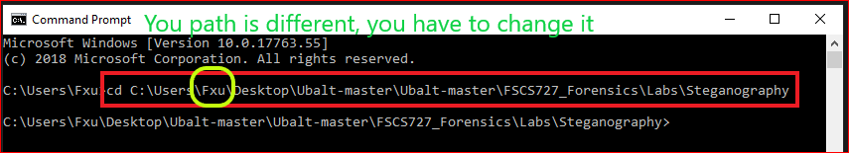
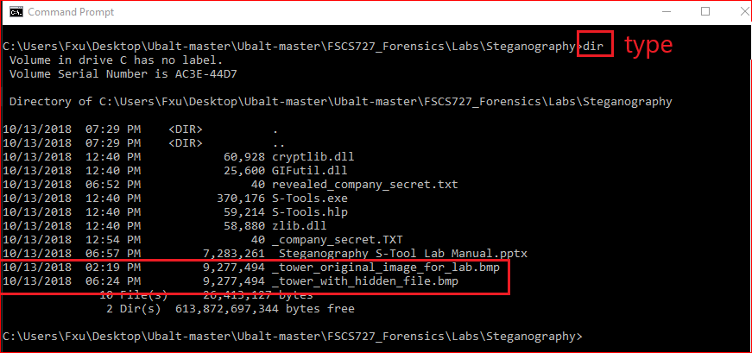

Slide 22
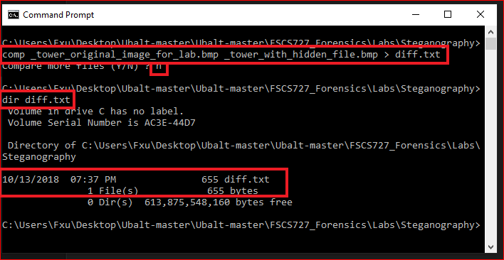

Slide 23
